Slide 1
Design Patterns

Slide 2
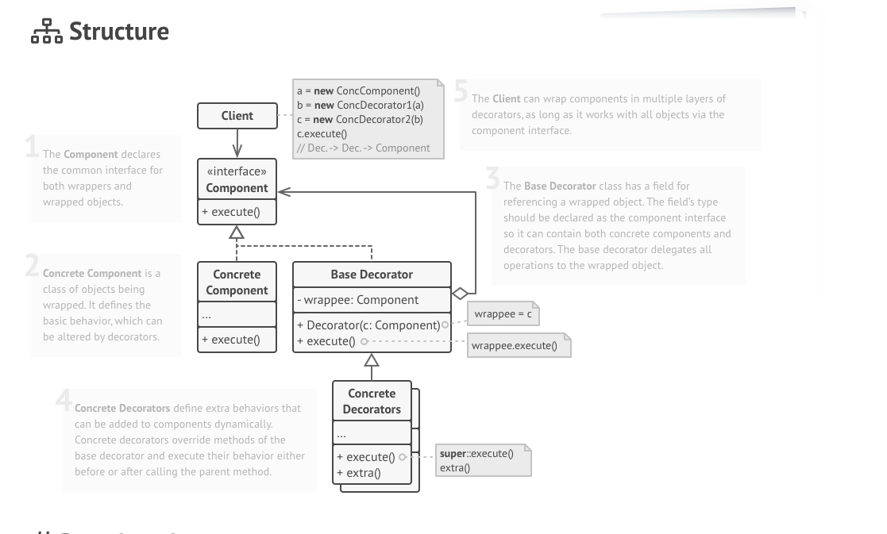
Decorator

Slide 3
Problem Statement
We have a Apartment complex from Prestige Builders.
Apartment requires Interiors.
Apartment complex with 10000 flats.
All are 2 BHK.
Customers can buy apartment only with Interiors.
Cost of every apartment is = 40 lakhs.
Interiors is mandatory for 5lakhs min.
Customer can choose to go for may be till 50 lakhs or more interiors.

Slide 4
Software solution for interior designing.
Interior designing
Interior estimates
Billing

Slide 5
Estimate Design
2BHK Flat
2BHK Flat with Bedroon
2BHK Flat with Kitchen interiors
2BHK Flat with Hall interiors
2BHK with Kitchen and hall interious
Std Kitchen – 5L
Italian – 2L+
Island – 3L+
Std Hall – 3L
Swing – 1L+
TV and Home theater – 2L+
Bedroom – 3L
TV station – 1L+
False cieling – 1L+

Slide 6
Estimate module
Report with total cost
Main product
+
Selected products
Report with Diagram

Slide 7
If Flat cannot modified then adding new types of decorator is a problem.
Enhancements are not possible without changes to base class.
2BHK Flat + std Kitchen+ Island + kids Bedroom
2BHK Flat + std Kitchen + Island
2BHKFlat
ArrayList<Interiors> list-interiors
int totalPrice()
void addInteriors(Interior interior)
2BHK Flat + std Kitchen
2BHK Flat
Exteriors
Painting
Gardening
Interiors
int price()
Boolean checkFeasibility(Flat)
PradeepFlat
BhadriFlat
Std kitchen
Kitchin island
Kids bedroom
Kitchen Italin top
Std kitchen
Island island
…..
…..

Slide 8
Exteriors
<Flat>
int price()
Association
Painting
Gardening
Composition
Aggregation
2BHKFlat
int price()
Island + Std kitchen + PradeepFlat
Std kitchen PradeepFlat
Interiors
- Flat flat
int price()
Boolean checkFeasibility(Flat)
decorate(Flat)
PradeepFlat
BhadriFlat
Std kitchen
kitchen island
Kids bedroom
Kitchen italian top
Std kitchen
Island island
…..
…..

Slide 9
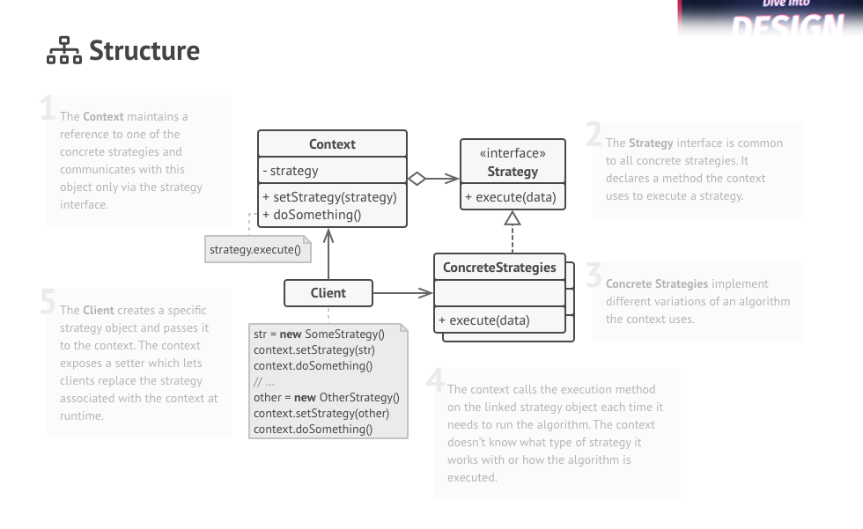
Stratergy
In Strategy pattern, we create objects which represent various strategies and a context object whose
behavior varies as per its strategy object.

Slide 10
Problem Statement
Find a house for rent.
Input: area and rent amount
Output: Rental Agreement
Sources to find rental houses
Internet Nobroker(without brokerage)
Internet CommonFloor(with Brokerage)
Human Broker
On Bike Manual search
e.g. Rajat, Near ITPL, 20000
Jawahar, Near ITPL, 100000

Slide 11
SearchEngine
+findHouse(Criteria)
Analyser
+Channel Analyze(Criteria criteria)
Client
HouseFinder
-Channel strategy
+selectChannel(Channel stratergy)
+findHouse(amount, location, urgency)
<Channel>
House Search(amount, location)
Nobroker
Commonfloor
HumanBroker
OnBikeSelf

Slide 12
 | Bhadri | Prapurna | Pradeep | Srinivas
Favorite |  | Observer | Factory | Command
Toughest | Command |  | Decorator | Decorator
Easiest |  | Adaptor | Singleton | Factory
Want to understand | State Pattern | Observer | Singleton | Command
Factory Pattern, Abstract Factory Pattern, Builder Pattern,
Singleton, Observer, Decorator, Adaptor, Strategy, Command Pattern, Facade Pattern, Proxy
State Pattern, Chain Of Responsibility, Composite Pattern

Slide 13
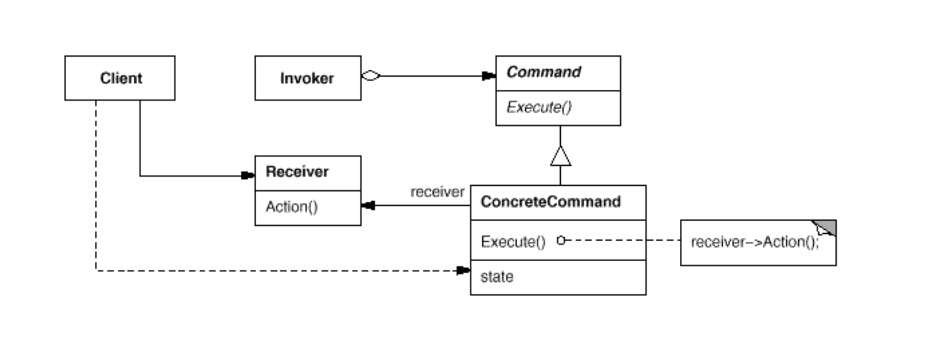
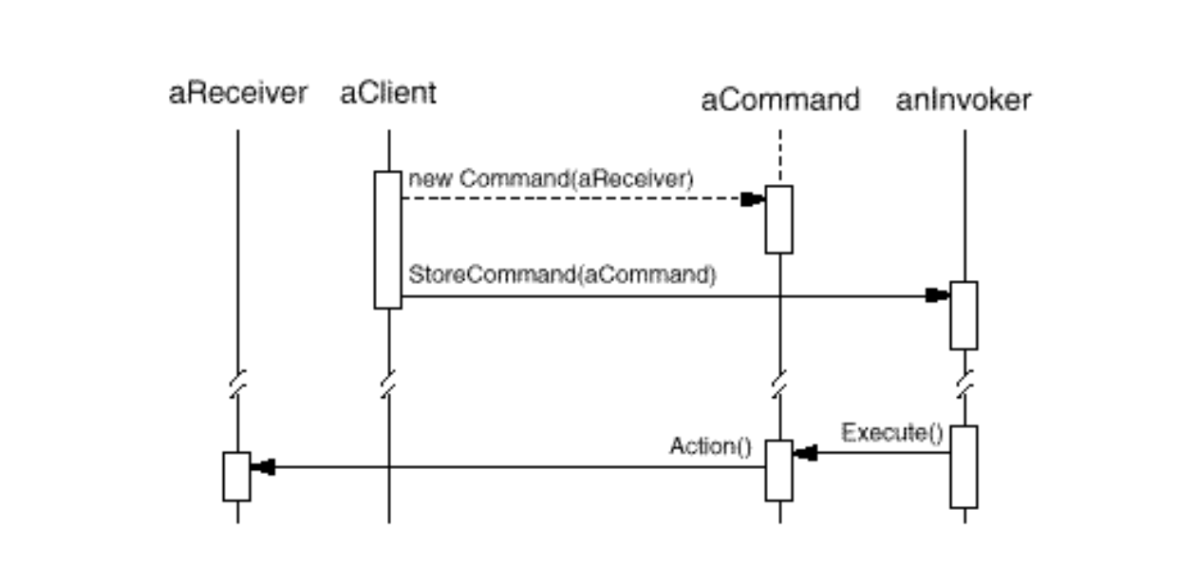
Command Pattern

Slide 14
Intent
Encapsulate a request as an object, thereby letting you parameterize clients with different requests, queue or log requests, and support undoable operations.

Slide 15
Definitions
Command design pattern is useful to abstract the business logic into discrete actions which we call commands. These command objects help in loose coupling between two classes where one class (invoker) shall call a method on other class (receiver) to perform a business operation.
Encapsulate a request as an object, thereby letting you parameterize clients with different requests, queue or log requests, and support undoable operations.

Slide 16
Interiors Implementation
e.g. Kitchen Interiors
Client--- Creates a specification()
Modify a specification()
Architect(specification ,Time)
Specification ->Plan → Tasks
TaskManager
Tasks1(Create, Read, Update, Delete)
Tasks2
….
Tasksn
Undo-Taskx
Redo-Taskx
Workers
-CarpenterMestri
-ElectricianMestri
-PlumberMestri
CRUD
Create
Read
Update
Delete
Tasks – Action -- Command

Slide 17
TaskManager(Invoker)
-List<Task>
+addTask(Task)
-invokeTasks(Task)
Architect(Client)
-Task(Worker)
Worker(Receiver)
+synchronousExecute(Task)
Client is associated with Recevier to have flexibility N:M mapping
<Task>(Command)
-Worker
+setWorker(Worker)
+Execute()
Painter
Mason
Carpenter
FlooringTask
+Execute()
PaintingTask
+Execute()
ItalianPlumbingTask
KitchenSlabTask

Slide 18
Database Resilience (Durability)
Every Command given to a database is first logged into a file.
If the database goes down before executing the command the database goes onto inconsistent state.
When database comes up it executes the logs first.
User/Application(Client)
Connection(Receiver)
Executor(Invoker)
Statement(Command)
-connection
Insert
Delete
Create

Slide 19
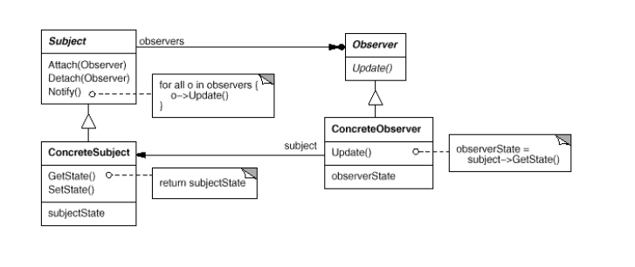
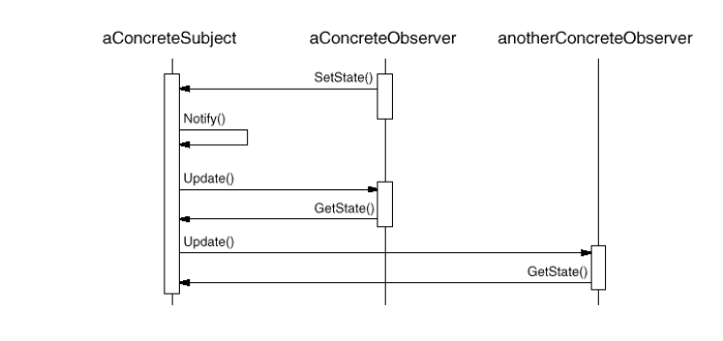
Observer Pattern

Slide 20
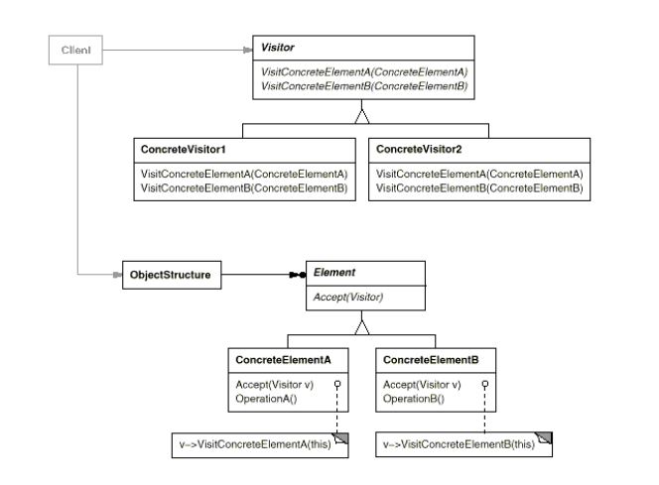
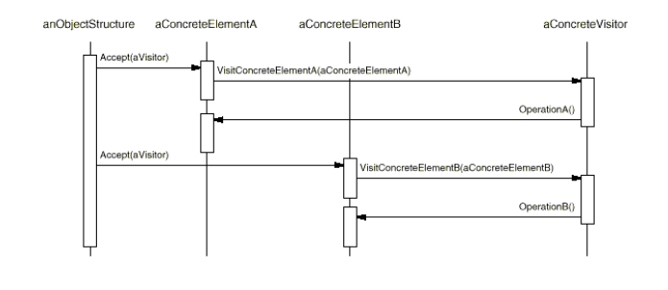
Visitor Pattern
Intent
Represent an operation to be performed on the elements of an object structure. Visitor lets you define a new operation without changing the classes of the elements on which it operates.

Slide 21
2BHK
List<Entities> entities;
invokedDesign(AbstractRoutine ar) {
ar.design2BHK();
}
InteriorEntity
2BHK
Kitchen
Slab
TopUnit
BottomUnit
Hall
AbstractRoutineDesign
+designKitchen()
+designSlab()
+designTopUnit()
+designBottomUnit()
+designSink()
+designHall()
+designShoeStand()
+designTVStand()
ShoeStand
TV Stand
Kitchen
invokedDesign(AbstractRoutine ar) {
ar.designKitchedn();
}
MasterBHK
WardRobe
InteriorEntity
+getname()
+getDescription
+size()
+position()
+invokeDesign(AbstractRoutine)
ItalianDesginRoutineDesign
+designKitchen()
+designSlab()
+designTopUnit()
+designBottomUnit()
+designSink()
+designHall()
+designShoeStand()
+designTVStand()
SwissDesignRoutineDesign
+designKitchen()
+designSlab()
+designTopUnit()
+designBottomUnit()
+designSink()
+designHall()
+designShoeStand()
+designTVStand()

Slide 22
Interior Design problem
2BHK
Kitchen
slab
Top Unit
Bottom Unit
Sink
Hall
TV stand
Shoe stand

Slide 23
InteriorEntity
2BHK
Kitchen
Slab
TopUnit
BottomUnit
Hall
AbstractRoutineVisitor
+designKitchen()
+designSlab()
+designTopUnit()
+designBottomUnit()
+designSink()
+designHall()
+designShoeStand()
+designTVStand()
ShoeStand
TV Stand
Kitchen
invokedDesign(AbstractRoutine ar) {
ar.designKitchedn();
}
MasterBHK
WardRobe
InteriorEntity
+getname()
+getDescription
+size()
+position()
+visit(AbstractRoutine)
ItalianDesginRoutineVisitor
+designKitchen()
+designSlab()
+designTopUnit()
+designBottomUnit()
+designSink()
+designHall()
+designShoeStand()
+designTVStand()
SwissDesignRoutineVisitor
+designKitchen()
+designSlab()
+designTopUnit()
+designBottomUnit()
+designSink()
+designHall()
+designShoeStand()
+designTVStand()

